Slide 1
Outline
Decision Trees and Ensemble Learning

Slide 2
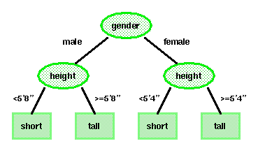
Decision Trees
A decision tree is an approach to predictive analysis that can help you make decisions.
A decision tree consists of nodes and leaves, with each leaf denoting a class.
Classes (tall or short) are the outputs of the tree.
Attributes (gender and height) are a set of features that describe the data.

Slide 3
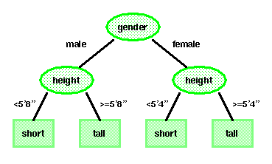
Basic Principles
The top, or first node, is called the root node.
The last level of nodes are the leaf nodes and contain the final classification.
The intermediate nodes are the descendant or “hidden” layers.
Binary trees, like the one shown to the right, are the most popular type of tree. However, M-ary trees (M branches at each node) are possible.
Decision trees attempt to classify a pattern through a sequence of questions. For example, attributes such as gender and height can be used to classify people as short or tall. But the best threshold for height is gender dependent. In a binary tree, by convention if the answer to a question is “yes”, the left branch is selected.
Key questions include how to grow the tree, how to stop growing, and how to prune the tree to increase generalization.

Slide 4
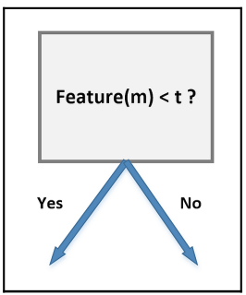
Binary decisions
A binary decision tree is a structure based on a sequential decision process. Starting from the root, a feature is evaluated and one of the two branches is selected. This procedure is repeated until a final leaf is reached, which normally represents the classification target.
Let's consider an input dataset X
In the dataset, we have n data points, and each point has m features. Then the decision tree might look like this where t is the threshold value
According to the feature and the threshold, the structure of the tree will change.

Slide 5
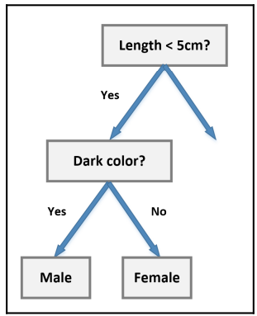
Binary decisions
It's necessary to find the feature that minimizes the number of following decision steps.
For example, let's consider a class of students where all males have dark hair and all females have blonde hair, while both subsets have samples of different sizes. If our task is to determine the composition of the class, we can start with the following subdivision:

Slide 6
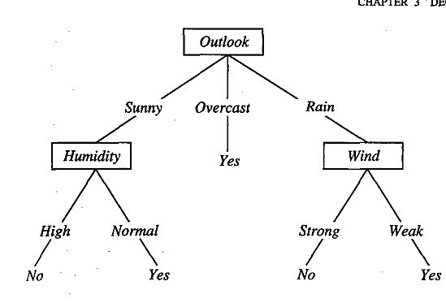
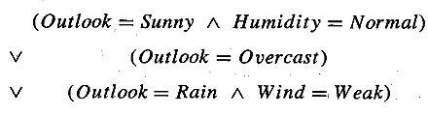
DECISION TREE REPRESENTATION
A decision tree can contain categorical data (YES/NO) as well as numeric data.
Figure illustrates a typical learned decision tree. This decision tree classifies Saturday mornings according to whether they are suitable for playing tennis.
For example, the instance (Outlook = Sunny, Temperature = Hot, Humidity = High, Wind = Strong) would be sorted down the leftmost branch of this decision tree and would therefore be classified as a negative instance (i.e., the tree predicts that PlayTennis = no).
The decision tree shown in Figure corresponds to the expression

Slide 7
How do Decision Trees work?
The decision of making strategic splits heavily affects a tree’s accuracy. The decision criteria are different for classification and regression trees.
Decision trees use multiple algorithms to decide to split a node into two or more sub-nodes. The creation of sub-nodes increases the homogeneity of resultant sub-nodes. In other words, we can say that the purity of the node increases with respect to the target variable. The decision tree splits the nodes on all available variables and then selects the split which results in most homogeneous sub-nodes.
The algorithm selection is also based on the type of target variables. Let us look at some algorithms used in Decision Trees:
ID3 → (extension of D3) C4.5 → (successor of ID3) CART → (Classification And Regression Tree) CHAID → (Chi-square automatic interaction detection Performs multi-level splits when computing classification trees) MARS → (multivariate adaptive regression splines)

Slide 8
How do Decision Trees work?
The ID3 algorithm builds decision trees using a top-down greedy search approach through the space of possible branches with no backtracking. A greedy algorithm, as the name suggests, always makes the choice that seems to be the best at that moment.
Steps in ID3 algorithm:
It begins with the original set S as the root node.
On each iteration of the algorithm, it iterates through the very unused attribute of the set S and calculates Entropy(H) and Information gain(IG) of this attribute.
It then selects the attribute which has the smallest Entropy or Largest Information gain.
The set S is then split by the selected attribute to produce a subset of the data.
The algorithm continues to recur on each subset, considering only attributes never selected before.

Slide 9
Attribute Selection Measures
If the dataset consists of N attributes then deciding which attribute to place at the root or at different levels of the tree as internal nodes is a complicated step. By just randomly selecting any node to be the root can’t solve the issue. If we follow a random approach, it may give us bad results with low accuracy.
For solving this attribute selection problem, researchers worked and devised some solutions. They suggested using some criteria like :
Entropy,
Information gain,
Gini index,
Gain Ratio,
Reduction in Variance
Chi-Square
These criteria will calculate values for every attribute. The values are sorted, and attributes are placed in the tree by following the order
Attribute with a high value(in case of information gain) is placed at the root.
While using Information Gain as a criterion, we assume attributes to be categorical, and
For the Gini index, attributes are assumed to be continuous.

Slide 10
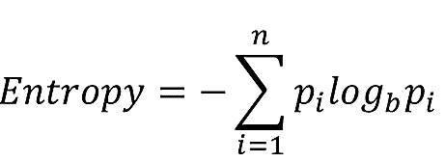
Entropy
Measures the level of impurity in a group of examples. Impurity is the degree of randomness; it tells how random our data is. if the target attribute can take on n different values, then the entropy of S relative to this n-wise classification is defined as:
Where p_{i} is the proportion of S belonging to class i. Note the logarithm is still base 2 because entropy is a measure of the expected encoding length measured in bits.
Now we can rewrite:
Entropy= -(p₁*log₂(p₁) + p₂*log₂(p₂) + .. + p_{n}*log₂(p_{n}))

Slide 11
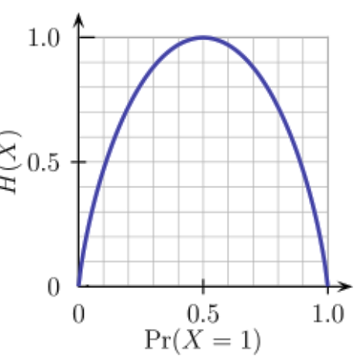
Entropy
Entropy is a measure of the randomness in the information being processed. The higher the entropy, the harder it is to draw any conclusions from that information. Flipping a coin is an example of an action that provides information that is random.
From the above graph, it is quite evident that the entropy H(X) is zero when the probability is either 0 or 1. The Entropy is maximum when the probability is 0.5 because it projects perfect randomness in the data and there is no chance if perfectly determining the outcome.

Slide 12
Information gain
Information gain or IG is a statistical property that measures how well a given attribute separates the training examples according to their target classification.
Constructing a decision tree is all about finding an attribute that returns the highest information gain and the smallest entropy.
Information gain measures the reduction of uncertainty given some feature and it is also a deciding factor for which attribute should be selected as a decision node or root node.
Information gain is used in both classification and regression decision trees. In classification, entropy is used as a measure of impurity, while in regression, variance is used as a measure of impurity

Slide 13
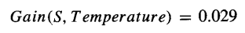
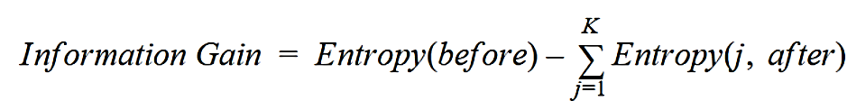
Information gain
Information gain is a decrease in entropy. It computes the difference between entropy before split and average entropy after split of the dataset based on given attribute values. ID3 (Iterative Dichotomiser) decision tree algorithm uses information gain.
In a much simpler way, we can conclude that:
Where “before” is the dataset before the split, K is the number of subsets generated by the split, and (j, after) is subset j after the split.

Slide 14
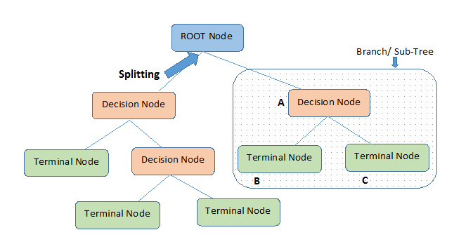
Important Terminology
Root Node: It represents the entire population or sample and this further gets divided into two or more homogeneous sets.
Splitting: It is a process of dividing a node into two or more sub-nodes.
Decision Node: When a sub-node splits into further sub-nodes, then it is called the decision node.
Leaf / Terminal Node: Nodes do not split is called Leaf or Terminal node.
Pruning: When we remove sub-nodes of a decision node, this process is called pruning. You can say the opposite process of splitting.
Branch / Sub-Tree: A subsection of the entire tree is called branch or sub-tree.

Slide 15
Decision Tree Algorithm
The decision tree algorithm can be used for solving regression and classification problems
The goal of using a Decision Tree is to create a training model that can use to predict the class or value of the target variable by learning simple decision rules inferred from training data.
In Decision Trees, for predicting a class label for a record we start from the root of the tree. We compare the values of the root attribute with the record’s attribute. On the basis of comparison, we follow the branch corresponding to that value and jump to the next node.

Slide 16
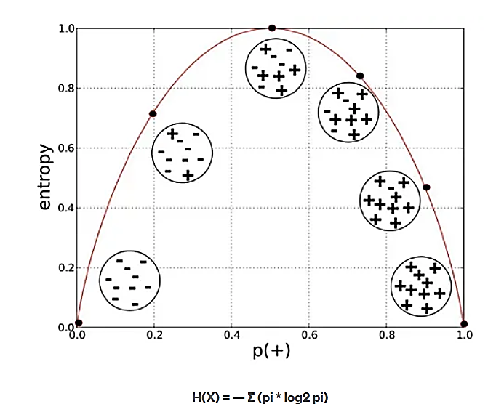
Decision Tree Algorithm
ID3 algorithm uses entropy to calculate the homogeneity of a sample. If the sample is completely homogeneous the entropy is zero and if the sample is an equally divided it has entropy of one.
ID3 stands for Iterative Dichotomiser 3 and is named such because the algorithm iteratively (repeatedly) dichotomizes(divides) features into two or more groups at each step. Invented by Ross Quinlan, ID3 uses a top-down greedy approach to build a decision tree.

Slide 17
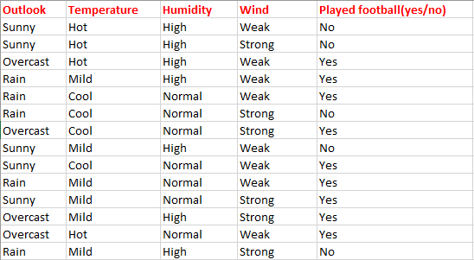
Classification using the ID3 algorithm
Consider a dataset based on which we will determine whether to play football or not.
Here There are four independent variables to determine the dependent variable.
The independent variables are Outlook, Temperature, Humidity, and Wind.
The dependent variable is whether to play football or not.

Slide 18
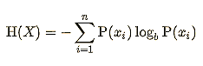
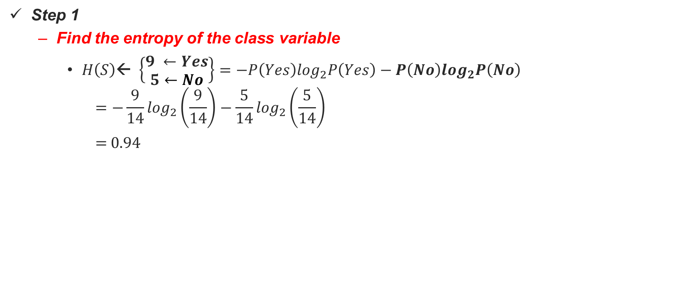
Calculations
Here
9 samples are Yes
5 samples are No
Step 1
Find the entropy of the class variable
$H\left(S\right)\text{← }\left\{\begin{aligned}9 ←Yes \\ 5←No\end{aligned}\right\}=−P\left(Yes\right)\log_{2}P\left(Yes\right)−P\left(No\right)\log_{2}P\left(No\right)$
$$=−\frac{9}{14}\log_{2}\left(\frac{9}{14}\right)−\frac{5}{14}\log_{2}\left(\frac{5}{14}\right)$$
= 0.94

Slide 19
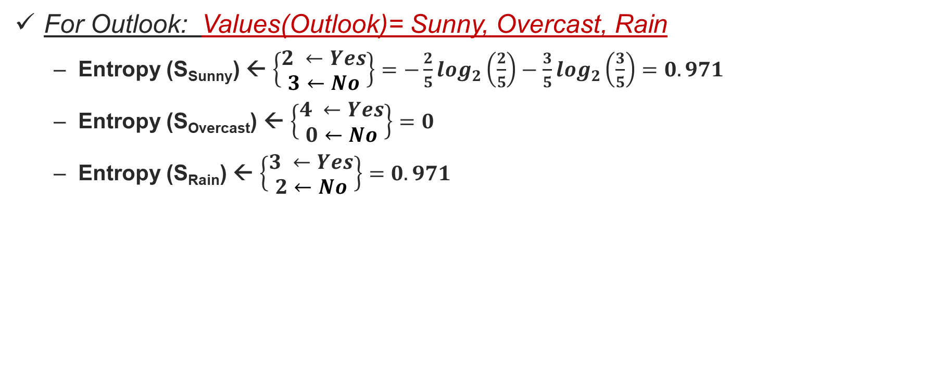
Step 2: Calculate average weighted entropy for each attribute
For Outlook: Values(Outlook)= Sunny, Overcast, Rain
Entropy (S_{Sunny}) ← $\left\{\begin{aligned}2 ←Yes \\ 3←No\end{aligned}\right\}=−\frac{2}{5}\log_{2}\left(\frac{2}{5}\right)−\frac{3}{5}\log_{2}\left(\frac{3}{5}\right)=0.971$
Entropy (S_{Overcast}) ← $\left\{\begin{aligned}4 ←Yes \\ 0←No\end{aligned}\right\}=0$
Entropy (S_{Rain}) ← $\left\{\begin{aligned}3 ←Yes \\ 2←No\end{aligned}\right\}=0.971$

Slide 20
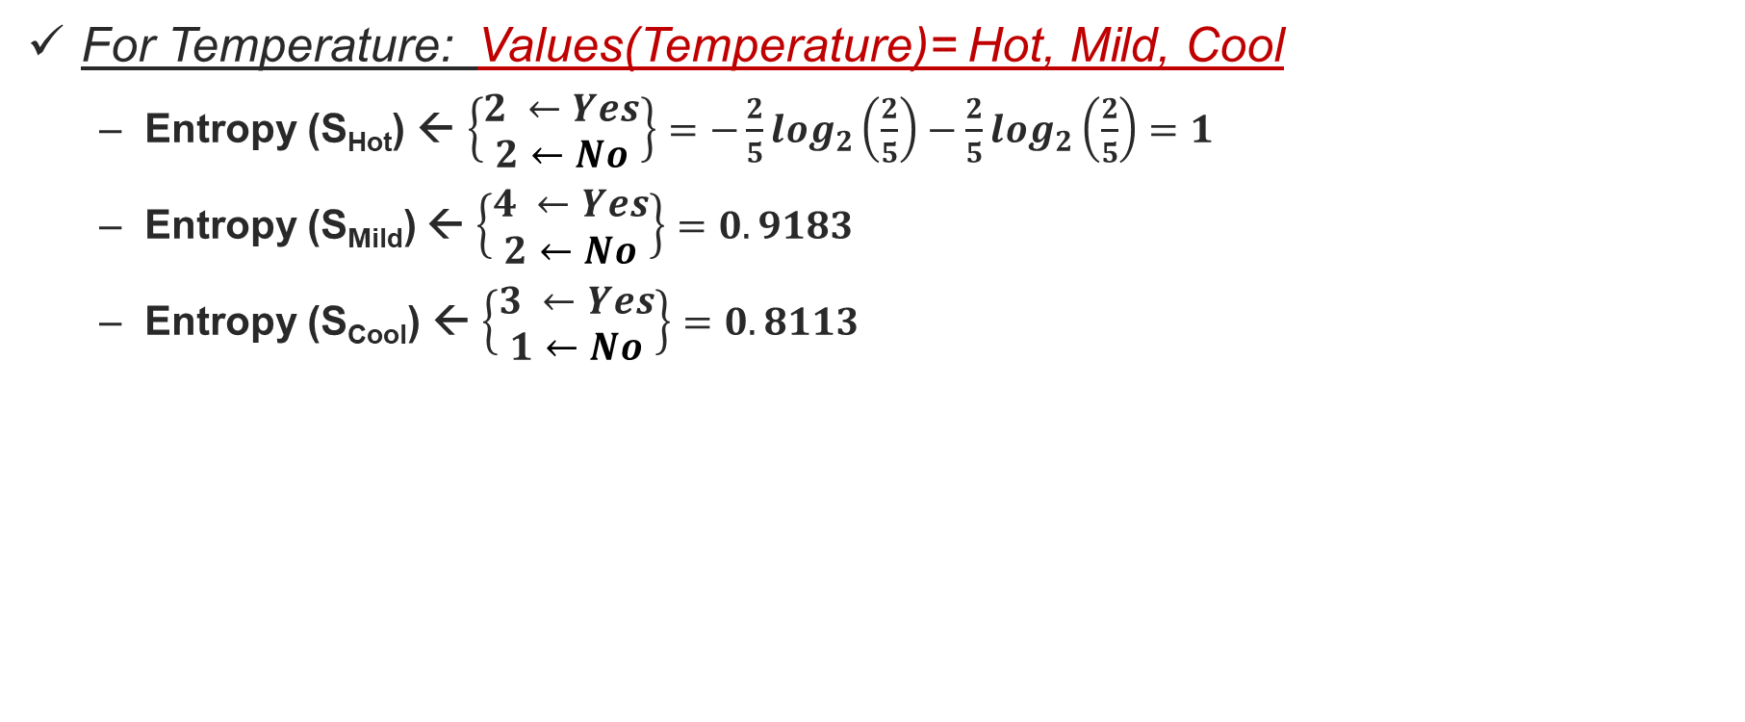
Step 2: Calculate average weighted entropy for each attribute (Cont…)
For Temperature: Values(Temperature)= Hot, Mild, Cool
Entropy (S_{Hot}) ← $\left\{\begin{aligned}2 ←Yes \\ 2←No\end{aligned}\right\}=−\frac{2}{5}\log_{2}\left(\frac{2}{5}\right)−\frac{2}{5}\log_{2}\left(\frac{2}{5}\right)=1$
Entropy (S_{Mild}) ← $\left\{\begin{aligned}4 ←Yes \\ 2←No\end{aligned}\right\}=0.9183$
Entropy (S_{Cool}) ← $\left\{\begin{aligned}3 ←Yes \\ 1←No\end{aligned}\right\}=0.8113$

Slide 21
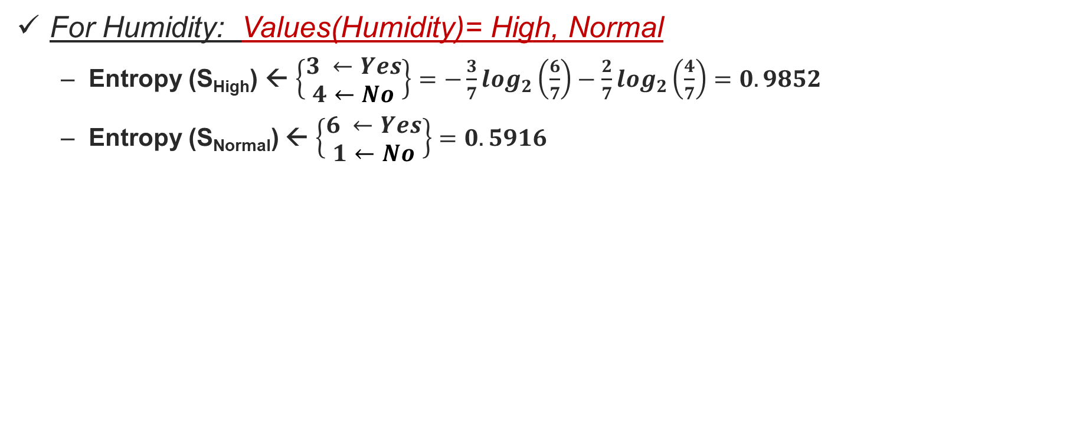
Step 2: Calculate average weighted entropy for each attribute (Cont…)
For Humidity: Values(Humidity)= High, Normal
Entropy (S_{High}) ← $\left\{\begin{aligned}3 ←Yes \\ 4←No\end{aligned}\right\}=−\frac{3}{7}\log_{2}\left(\frac{6}{7}\right)−\frac{2}{7}\log_{2}\left(\frac{4}{7}\right)=0.9852$
Entropy (S_{Normal}) ← $\left\{\begin{aligned}6 ←Yes \\ 1←No\end{aligned}\right\}=0.5916$

Slide 22
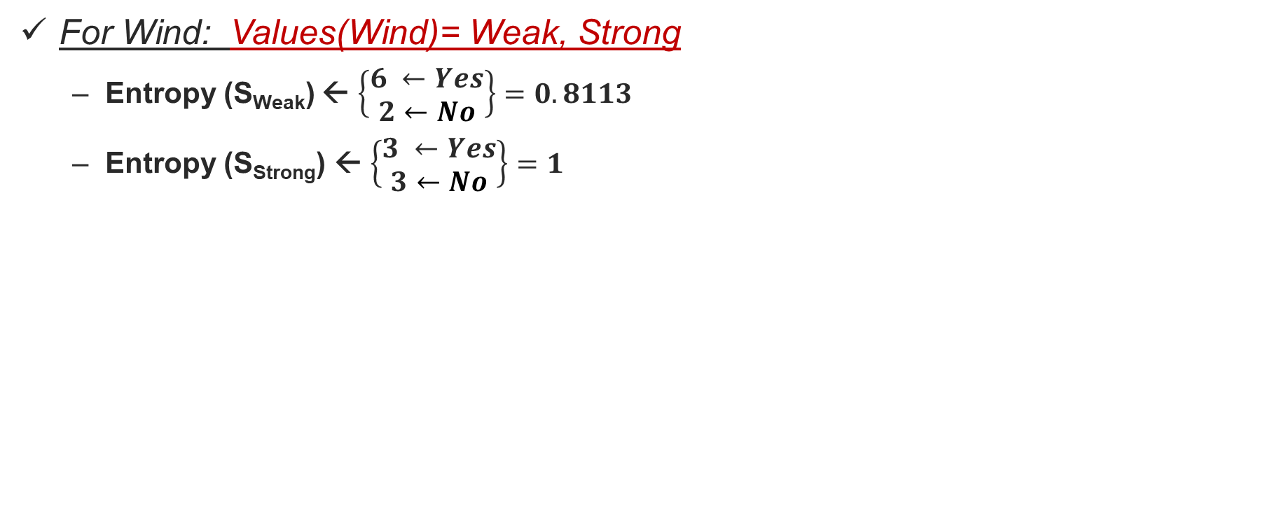
Step 2: Calculate average weighted entropy for each attribute (Cont…)
For Wind: Values(Wind)= Weak, Strong
Entropy (S_{Weak}) ← $\left\{\begin{aligned}6 ←Yes \\ 2←No\end{aligned}\right\}=0.8113$
Entropy (S_{Strong}) ← $\left\{\begin{aligned}3 ←Yes \\ 3←No\end{aligned}\right\}=1$

Slide 23
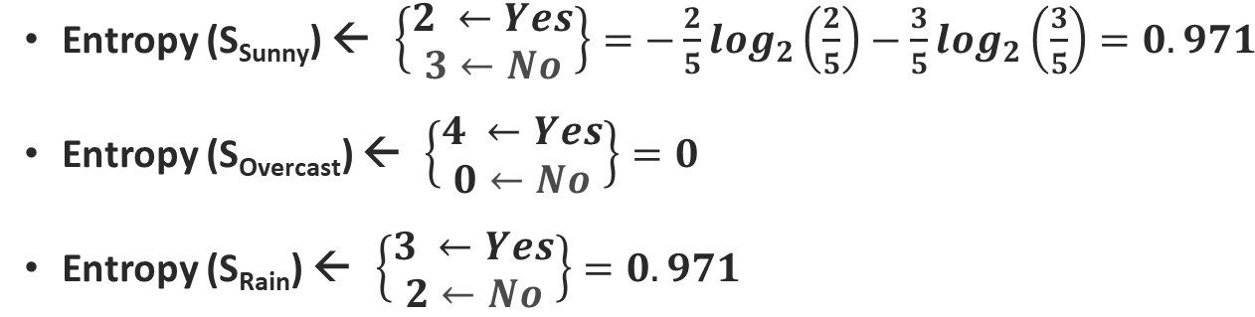
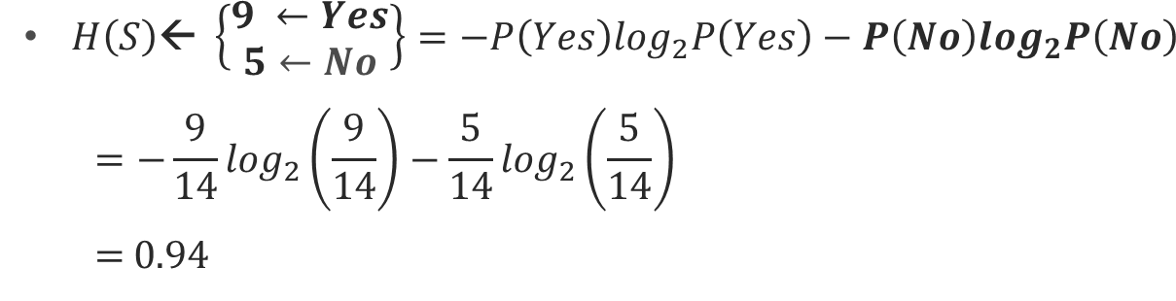
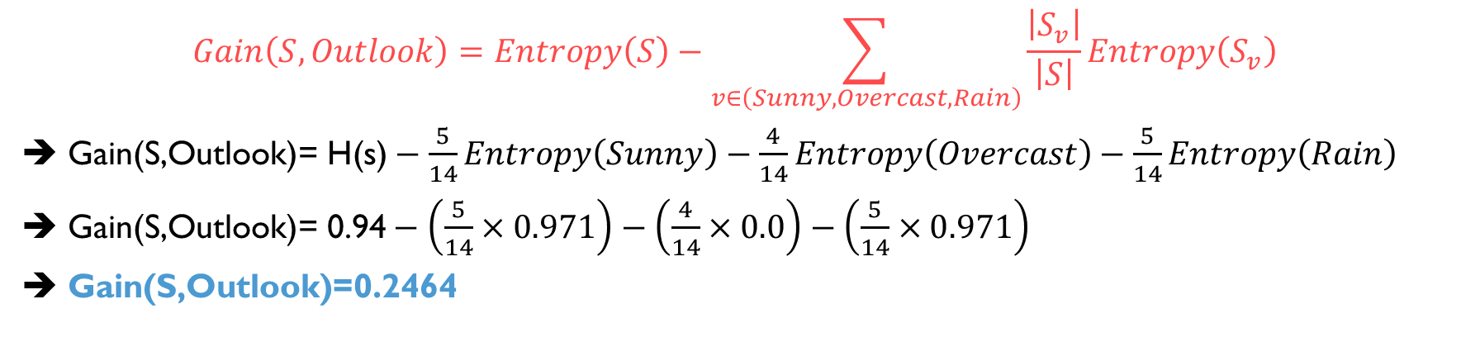
Step3: Find the information gain: Outlook
Information gain is the difference between parent entropy and average weighted entropy we found above.
$$Gain\left(S,Outlook\right)=Entropy\left(S\right)−\sum_{v∈\left(Sunny, Overcast, Rain\right)}{\frac{\left|S_{v}\right|}{\left|S\right|}Entropy\left(S_{v}\right)}$$
➔ $\text{G}\text{ain}\text{(}\text{S}\text{,}\text{Outlook}\text{)= }\text{H}\text{(}\text{s}\text{)}−\frac{5}{14}Entropy\left(Sunny\right)−\frac{4}{14}Entropy\left(Overcast\right)−\frac{5}{14}Entropy\left(Rain\right)$
➔ $\text{G}\text{ain}\text{(}\text{S}\text{,}\text{Outlook}\text{)= 0.94}−\left(\frac{5}{14}×0.971\right)−\left(\frac{4}{14}×0.0\right)−\left(\frac{5}{14}×0.971\right)$
➔ $\text{Gain}\text{(}\text{S}\text{,}\text{Outlook}\text{)=0.2464}$

Slide 24
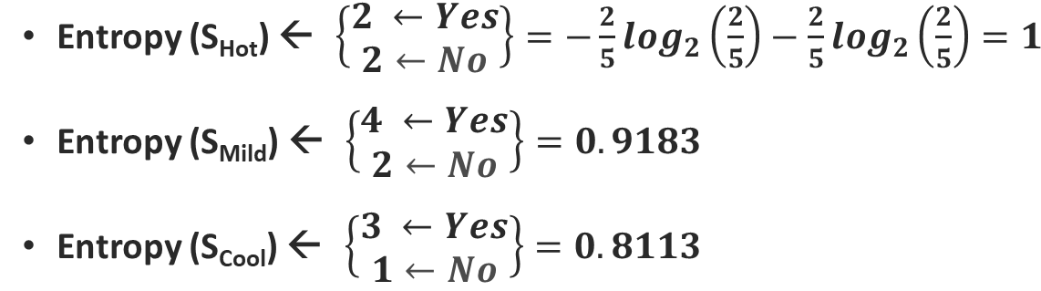
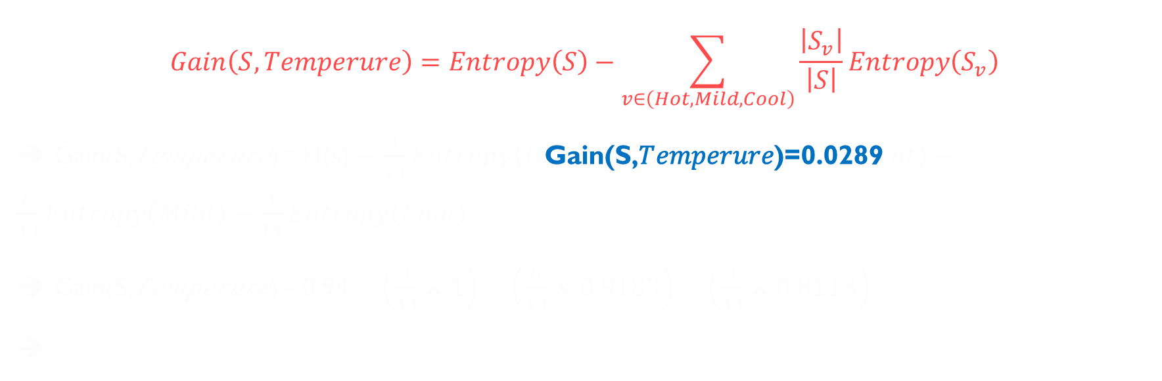
Gain: Temperature
$$Gain\left(S,Temperure\right)=Entropy\left(S\right)−\sum_{v∈\left(Hot, Mild, Cool\right)}{\frac{\left|S_{v}\right|}{\left|S\right|}Entropy\left(S_{v}\right)}$$
➔ $\text{G}\text{ain}\text{(}\text{S}\text{,}\text{Temperure}\text{)= }\text{H}\text{(}\text{s}\text{)}−\frac{4}{14}Entropy\left(H\text{Gain}\text{(}\text{S}\text{,}\text{Temperure}\text{)=0.0289 }ot\right)−\frac{6}{14}Entropy\left(Mild\right)−\frac{4}{14}Entropy\left(Cool\right)$
➔ $\text{Gain}\text{(}\text{S}\text{,}\text{Temperure}\text{)= 0.94}−\left(\frac{4}{14}×1\right)−\left(\frac{6}{14}×0.9183\right)−\left(\frac{4}{14}×0.8113\right)$
➔

Slide 25
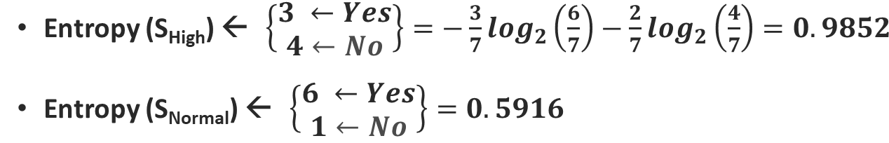
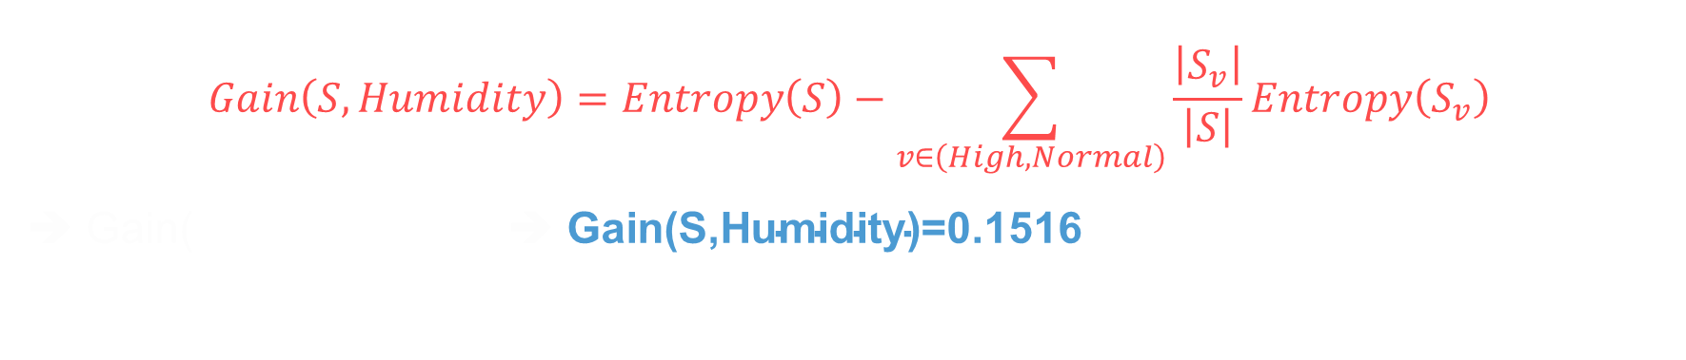
Gain: Humidity
$$Gain\left(S,Humidity\right)=Entropy\left(S\right)−\sum_{v∈\left(High, Normal\right)}{\frac{\left|S_{v}\right|}{\left|S\right|}Entropy\left(S_{v}\right)}$$
➔ $\text{G}\text{ain}\text{(}$ ➔ $\text{Gain}\text{(}\text{S}\text{,}\text{Humidity}\text{)=0.}\text{1516}$

Slide 26
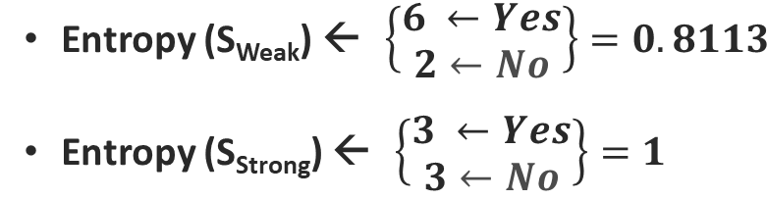
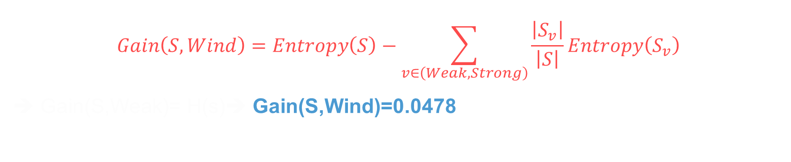
Gain: Wind
$$Gain\left(S,Wind\right)=Entropy\left(S\right)−\sum_{v∈\left(Weak, Strong\right)}{\frac{\left|S_{v}\right|}{\left|S\right|}Entropy\left(S_{v}\right)}$$
➔ $\text{G}\text{ain}\text{(}\text{S}\text{,}\text{Weak}\text{)= }\text{H}\text{(}\text{s}\text{)}$➔ $\text{Gain}\text{(}\text{S}\text{,}\text{Wind}\text{)=0.}\text{0478}$

Slide 27
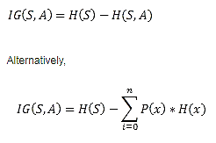
Information gain
IG(S, outlook) = 0.94 - 0.693 = 0.247
IG(S, Temperature) = 0.940 - 0.911 = 0.029
IG(S, Humidity) = 0.940 - 0.788 = 0.152
IG(S, Windy) = 0.940 - 0.8932 = 0.048

Slide 28
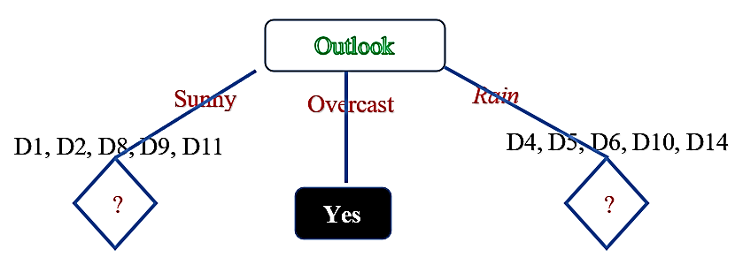
Finding Root Node
Since Outlook has the highest gain so, Outlook is the root node. And it has three child nodes (Sunny, Overcast, Rain)

Slide 29
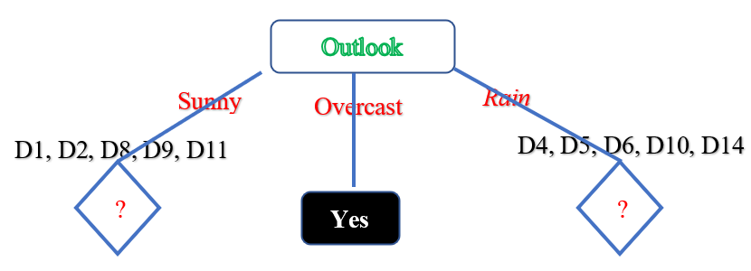
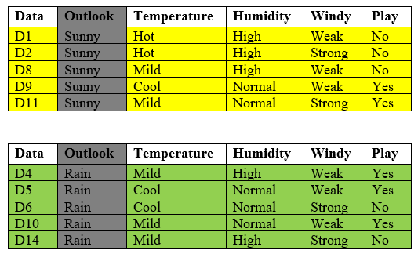
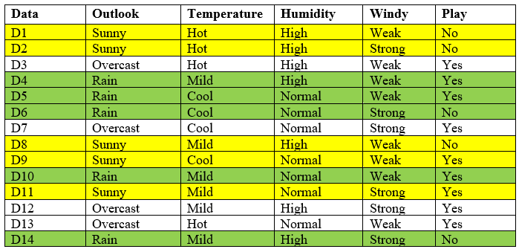

Slide 30
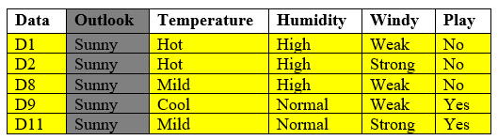
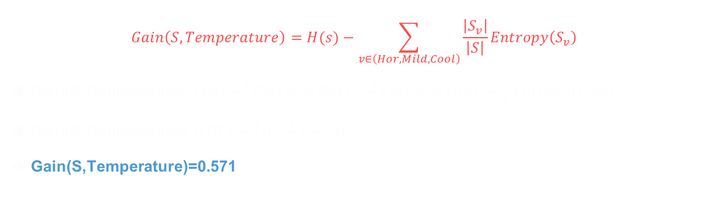
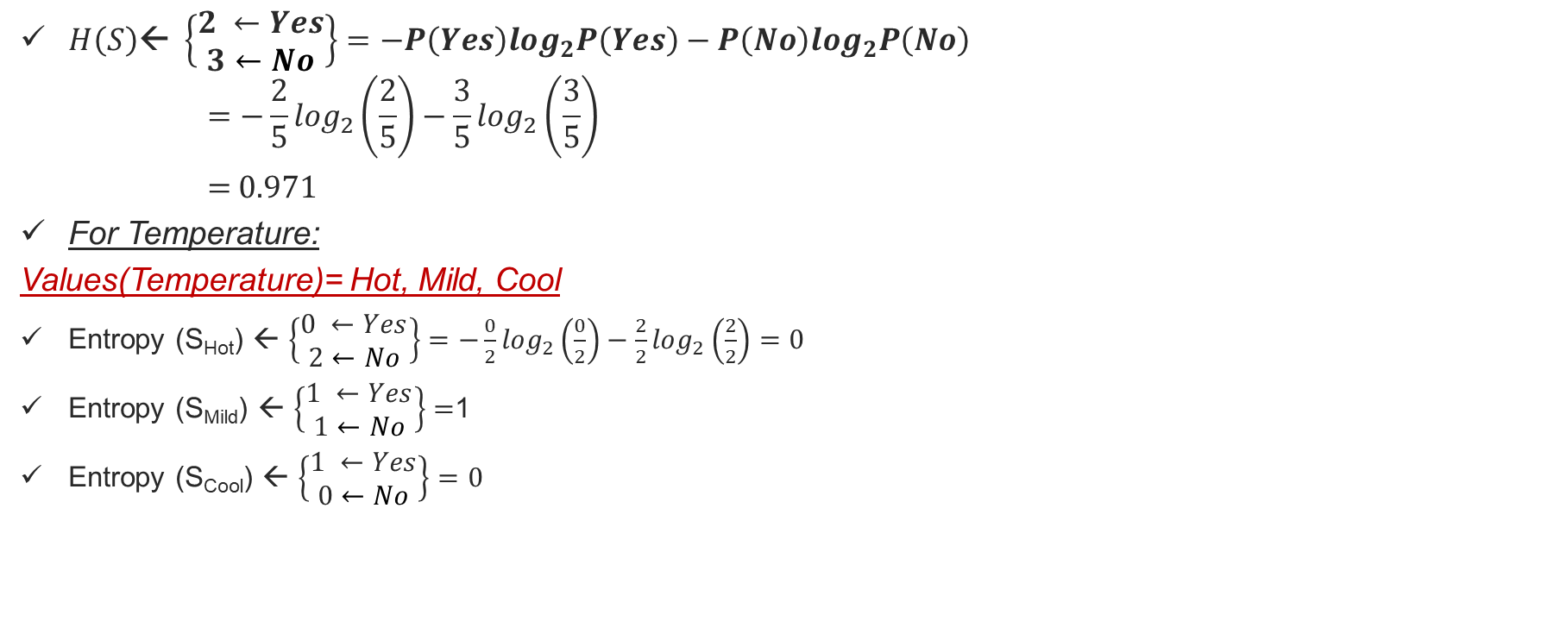
Calculate IG of Temperature
$H\left(S\right)\text{← }\left\{\begin{aligned}2 ←Yes \\ 3←No\end{aligned}\right\}=−P\left(Yes\right)\log_{2}P\left(Yes\right)−P\left(No\right)\log_{2}P\left(No\right)$
$$=−\frac{2}{5}\log_{2}\left(\frac{2}{5}\right)−\frac{3}{5}\log_{2}\left(\frac{3}{5}\right)$$
= 0.971
For Temperature:
Values(Temperature)= Hot, Mild, Cool
Entropy (S_{Hot}) ← $\left\{\begin{aligned}0 ←Yes \\ 2←No\end{aligned}\right\}=−\frac{0}{2}\log_{2}\left(\frac{0}{2}\right)−\frac{2}{2}\log_{2}\left(\frac{2}{2}\right)=0$
Entropy (S_{Mild}) ← $\left\{\begin{aligned}1 ←Yes \\ 1←No\end{aligned}\right\}=$1
Entropy (S_{Cool}) ← $\left\{\begin{aligned}1 ←Yes \\ 0←No\end{aligned}\right\}=0$
$$Gain\left(S,Temperature\right)=H(s)−\sum_{v∈\left(Hor, Mild, Cool\right)}{\frac{\left|S_{v}\right|}{\left|S\right|}Entropy\left(S_{v}\right)}$$
➔ $\text{G}\text{ain}\text{(}\text{S}\text{,}\text{Temperature}\text{)= }\text{H}\text{(}\text{s}\text{)}−\frac{2}{5}Entropy\left(Hot\right)−\frac{2}{5}Entropy\left(Mild\right)−\frac{1}{5}Entropy\left(Cool\right)$
➔ $\text{Gain}\text{(}\text{S}\text{,}\text{Temperature}\text{)= 0.}\text{971}−\frac{2}{5}0−\frac{2}{5}1−\frac{1}{5}0$
➔ $\text{Gain}\text{(}\text{S}\text{,}\text{Temperature}\text{)=0.}\text{571}$

Slide 31
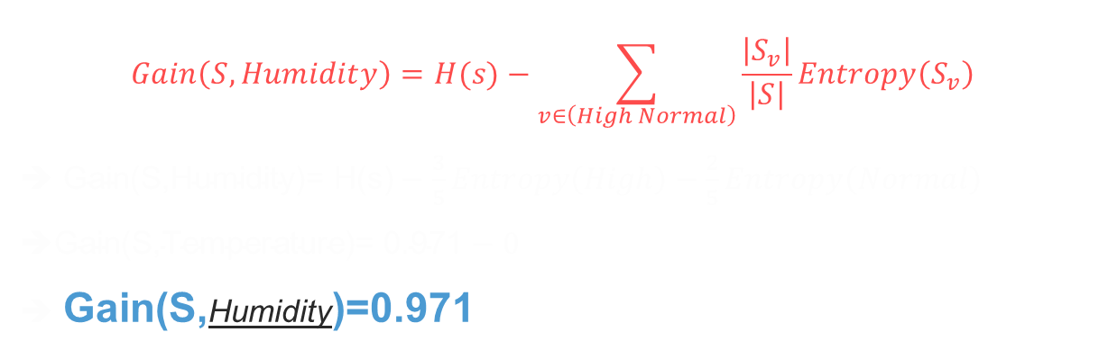
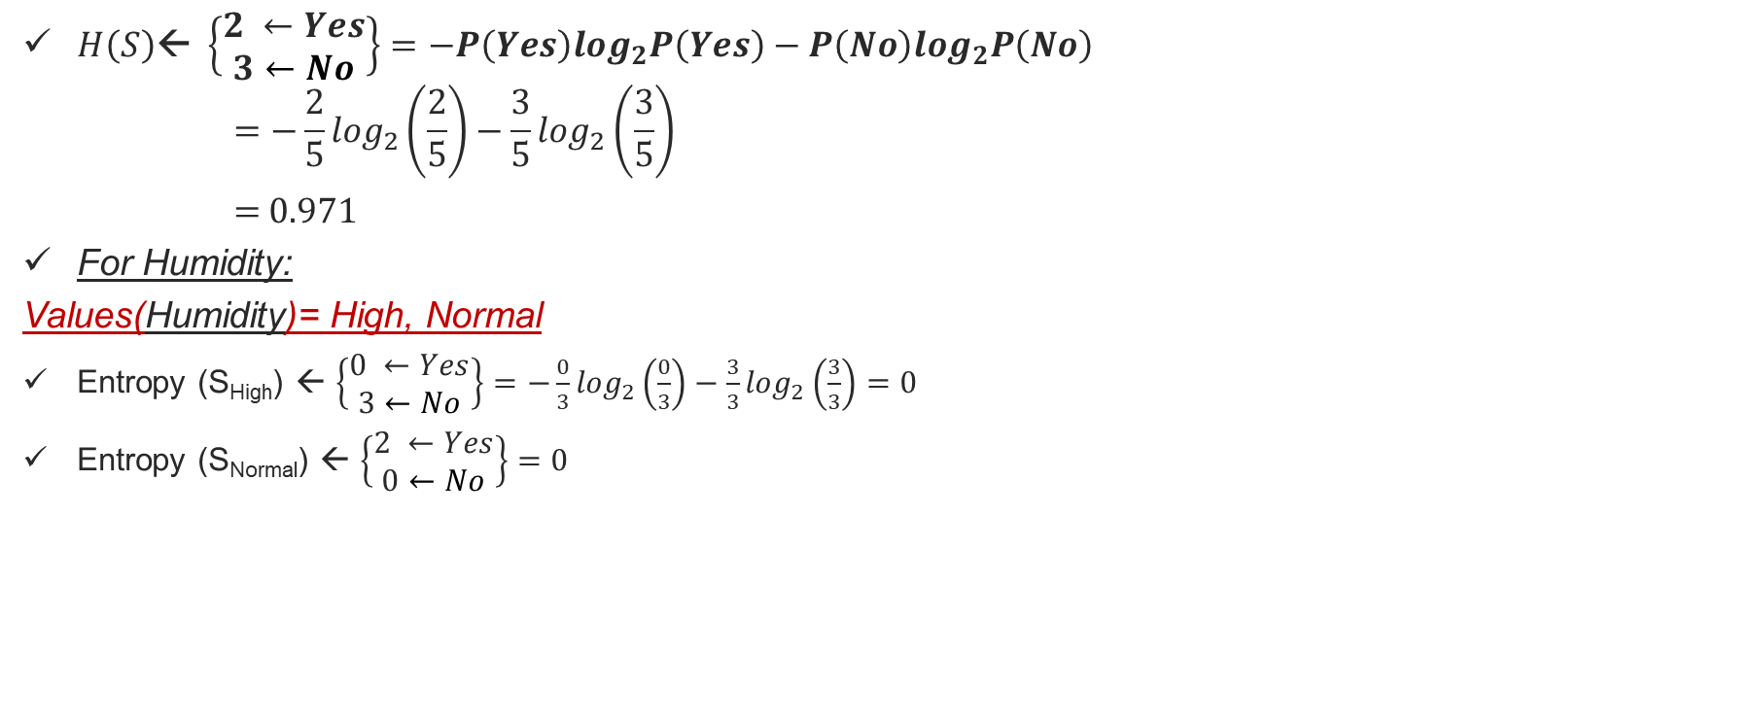
Calculate IG of Humidity
$H\left(S\right)\text{← }\left\{\begin{aligned}2 ←Yes \\ 3←No\end{aligned}\right\}=−P\left(Yes\right)\log_{2}P\left(Yes\right)−P\left(No\right)\log_{2}P\left(No\right)$
$$=−\frac{2}{5}\log_{2}\left(\frac{2}{5}\right)−\frac{3}{5}\log_{2}\left(\frac{3}{5}\right)$$
= 0.971
For Humidity:
Values(Humidity)= High, Normal
Entropy (S_{High}) ← $\left\{\begin{aligned}0 ←Yes \\ 3←No\end{aligned}\right\}=−\frac{0}{3}\log_{2}\left(\frac{0}{3}\right)−\frac{3}{3}\log_{2}\left(\frac{3}{3}\right)=0$
Entropy (S_{Normal}) ← $\left\{\begin{aligned}2 ←Yes \\ 0←No\end{aligned}\right\}=0$
$$Gain\left(S,Humidity\right)=H(s)−\sum_{v∈\left(High Normal\right)}{\frac{\left|S_{v}\right|}{\left|S\right|}Entropy\left(S_{v}\right)}$$
➔ $\text{G}\text{ain}\text{(}\text{S}\text{,}\text{Humidity}\text{)= }\text{H}\text{(}\text{s}\text{)}−\frac{3}{5}Entropy\left(High\right)−\frac{2}{5}Entropy\left(Normal\right)$
$\text{Gain}\text{(}\text{S}\text{,}\text{Temperature}\text{)= 0.}\text{971}−0$
$\text{Gain}\text{(}\text{S}\text{,}\text{Humidity}\text{)=0.}\text{971}$

Slide 32
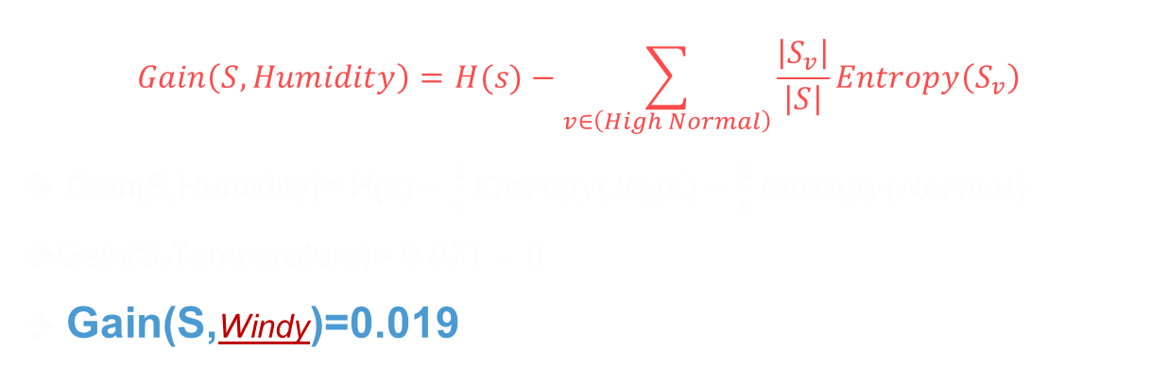
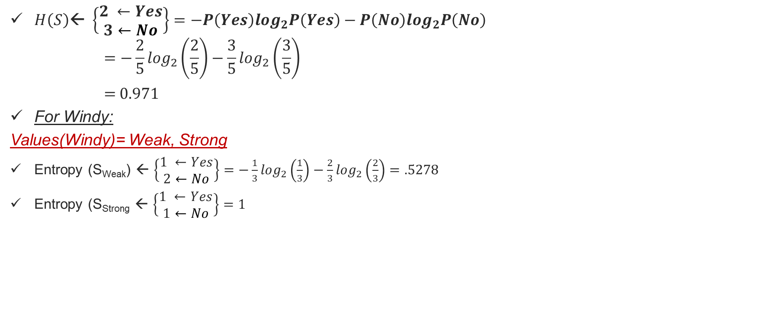
Calculate IG of Windy
$H\left(S\right)\text{← }\left\{\begin{aligned}2 ←Yes \\ 3←No\end{aligned}\right\}=−P\left(Yes\right)\log_{2}P\left(Yes\right)−P\left(No\right)\log_{2}P\left(No\right)$
$$=−\frac{2}{5}\log_{2}\left(\frac{2}{5}\right)−\frac{3}{5}\log_{2}\left(\frac{3}{5}\right)$$
= 0.971
For Windy:
Values(Windy)= Weak, Strong
Entropy (S_{Weak}) ← $\left\{\begin{aligned}1 ←Yes \\ 2←No\end{aligned}\right\}=−\frac{1}{3}\log_{2}\left(\frac{1}{3}\right)−\frac{2}{3}\log_{2}\left(\frac{2}{3}\right)=.5278$
Entropy (S_{Strong} ← $\left\{\begin{aligned}1 ←Yes \\ 1←No\end{aligned}\right\}=1$
$$Gain\left(S,Humidity\right)=H(s)−\sum_{v∈\left(High Normal\right)}{\frac{\left|S_{v}\right|}{\left|S\right|}Entropy\left(S_{v}\right)}$$
➔ $\text{G}\text{ain}\text{(}\text{S}\text{,}\text{Humidity}\text{)= }\text{H}\text{(}\text{s}\text{)}−\frac{3}{5}Entropy\left(High\right)−\frac{2}{5}Entropy\left(Normal\right)$
$\text{Gain}\text{(}\text{S}\text{,}\text{Temperature}\text{)= 0.}\text{971}−0$
$\text{Gain}\text{(}\text{S}\text{,}\text{Windy}\text{)=0.}\text{019}$

Slide 33
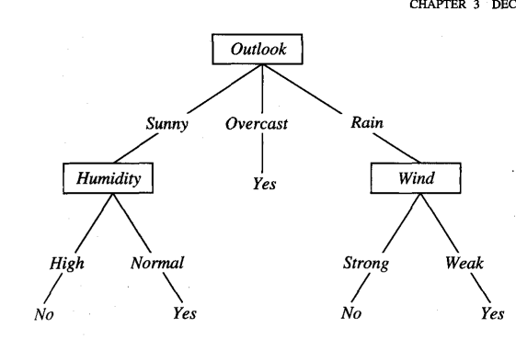
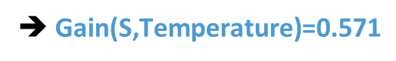
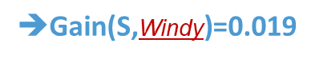
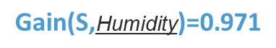
Information gain
➔ $\text{Gain}\text{(}\text{S}\text{,}\text{Temperature}\text{)=0.571}$
$$\text{Gain}\text{(}\text{S}\text{,}\text{Humidity}\text{)=0.971}$$
$\text{Gain}\text{(}\text{S}\text{,}\text{Windy}\text{)=0.019}$

Slide 34
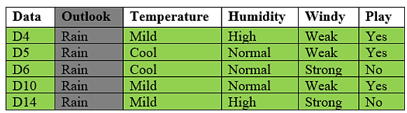
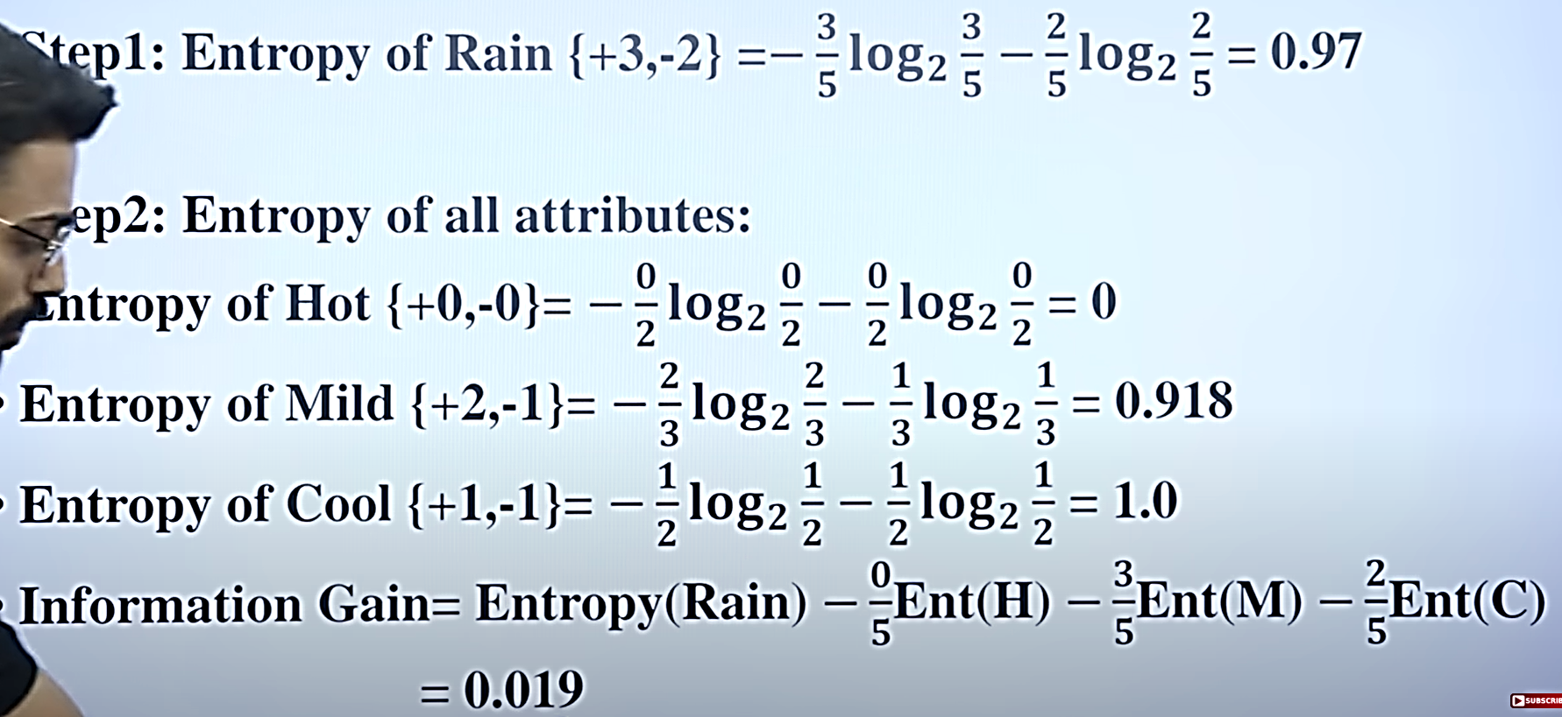
Calculate IG of Temperature

Slide 35
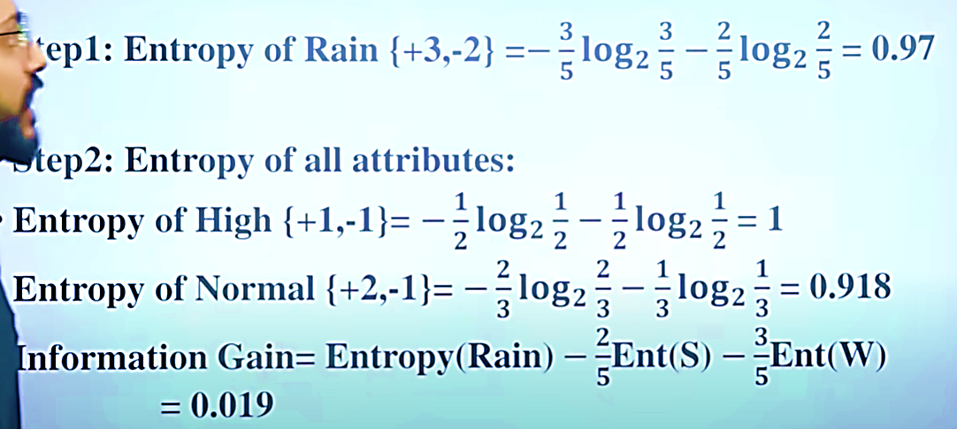
Calculate IG of Humidity

Slide 36
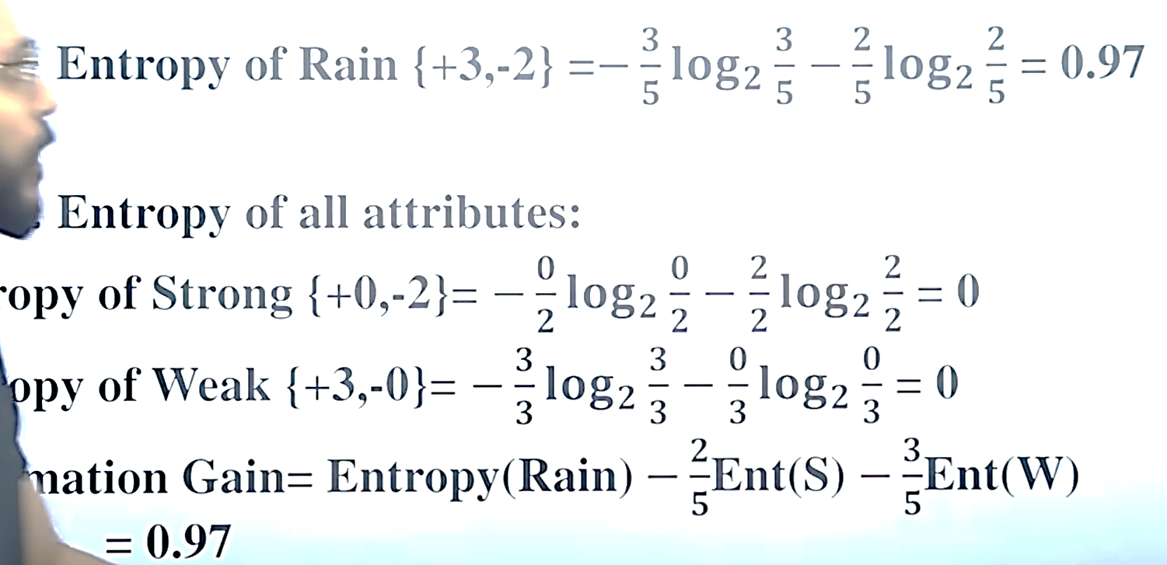
Calculate IG of Windy

Slide 37
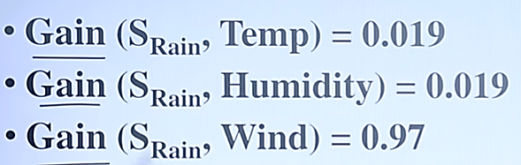
Information gain

Slide 38

A decision tree for the concept PlayTennis
An example is classified by sorting it through the tree to the appropriate leaf node, then returning the classification associated with this leaf (in this case, Yes or No).
This tree classifies Saturday mornings according to whether or not they are suitable for playing tennis.

Slide 39
CART Algorithm
The CART (Classification and Regression Trees) algorithm is a decision tree learning algorithm that can be used for both classification and regression problems in machine learning. It works by recursively partitioning the training data into smaller subsets using binary splits.
CART is a powerful and popular algorithm due to its ability to handle both categorical and continuous features,
CART algorithm is developed by Leo Breiman and Jerome Friedman.
It uses the Gini impurity measure for classification trees and the mean squared error for regression trees.
CART algorithm always creates a binary tree, which means that each non-terminal node has two child nodes. This is in contrast with other tree-based methods, which may allow multiple child nodes
Notes:
ID3 (Iterative Dichotomiser 3) was developed by Ross Quinlan and is used for constructing decision trees. It uses entropy and information gain to decide which attribute is the best to split on at each step. C4.5 is an extension of ID3 and was also developed by Ross Quinlan. C4.5 and C5.0 work with both Discrete and Continuous data.
It includes improvements such as the ability to handle both continuous and discrete attributes, handling of missing data, and pruning of decision trees to avoid overfitting.

Slide 40
Gini Index
Steps 1 Calculate the Gini impurity for the entire dataset. This is the impurity of the root node.
Steps 2 For each input variable, calculate the Gini impurity for all possible split points. The split point that results in the minimum Gini impurity is chosen.
Steps 3 The data is split into two subsets based on the chosen split point, and a new node is created for each subset.
Steps 4 Steps 2 and 3 are repeated for each new node, until a stopping criterion is met. This stopping criterion could be a maximum tree depth, a minimum number of data points in a leaf node, or a minimum reduction in impurity.
Steps 5 The resulting tree is the decision tree.
Gini impurity is a measure of the quality of a split in a decision tree algorithm. Given a sample, the Gini impurity measures the probability of a misclassification if a label is randomly chosen using the probability distribution of the branch.
The Gini impurity of a node can be calculated as follows:
Gini = 1 - ∑(p_{i})²
Here, p_{i} is the probability that a tuple in D belongs to the class C_{i}.
The index reaches its minimum (0.0) when all the samples of a node are classified into a single category.
Notes:
It measures the probability of misclassification of a random sample. The Gini impurity measures how often a randomly chosen element from the set would be incorrectly labeled if it were randomly labeled according to the distribution of labels in the subset.

Slide 41
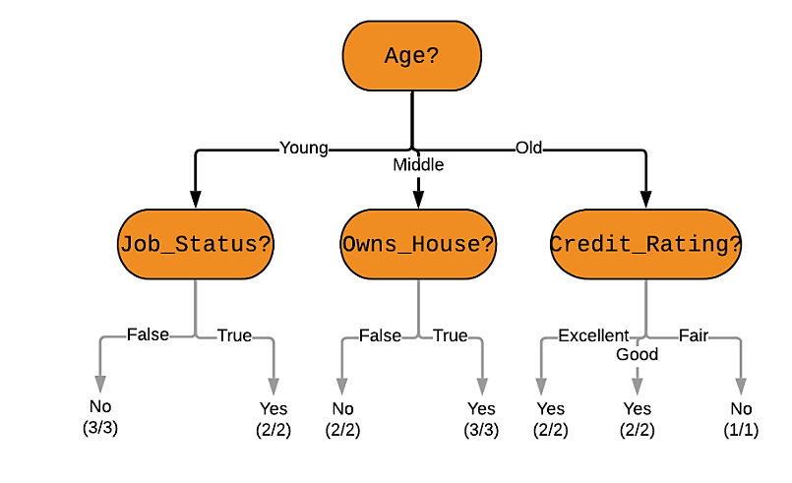
Example
Here is the goal: Use the model to classify future loan applications into one of these classes:
Yes (approved) and
No (not approved)
Let us clasify the following applicant whose record looks like this: Age: Young Job_Status: False Owns_House: False Credit_Rating: Good What would a decision tree look like for the above problem? Here is one example of a decision tree -

Slide 42

Find Gini Index
Step 1: Find Gini(D) In our case, Gini(D) = 1 - (9/15)² - (6/15)² = 0.48 [since we have 9 Yes and 6 No class values
for the 15 total records]
Step 2: Find Gini_{k}(D) for each attribute k Gini_{k}(D) = ∑|D_{i}|/|D| * Gini(D_{i}) For i = 1 to n, where D_{i} is a partition of the dataset D
So, for the attribute Owns_House: Gini_{Owns_House}(D) = (6/15) * Gini(D_{Owns_House = True}) + (9/15) * Gini(D_{Owns_House = False})
= (6/15) * [1 - (6/6)² - (0/6)²] + (9/15) * [1 - (3/9)² - (6/9)²]
= 0.267
And for the Age attribute: Gini_{Age}(D) = (5/15) * Gini(D_{Age = Young}) + (5/15) * Gini(D_{Age = Middle}) + (5/15) * Gini(D_{Age = Old}) = 0.426
Similarly, we can find the Gini Indices for the other attributes: Gini_{Credit_Rating}(D) = 0.284 Gini_{Job_Status}(D) = 0.32 (try calculating these yourself!)

Slide 44

Sample DT
Own_House
YES
(6/6)
D1, D2, D3, D5, D6, D7, D13, D14, D15

Slide 46
Own_House
YES
(6/6)

Slide 47

Partition at Minimum Gini Index Values
Step 3: Partition at Minimum Gini Index Values As stated above, we need the root node of the decision tree to have the lowest possible Gini Index, and in our case that is the attribute Owns_House. The next attribute is Job_Status.
This is how we ultimately arrive at this decision tree –
And using this decision tree for our problem - we can see that the applicant does not own a house, and does not have a job. Unfortunately, his loan will not be approved.

Slide 48
Prediction using CARTs
We saw that decision trees can be classified into two types: Classification trees which are used to separate a dataset into different classes (generally used when we expect categorical classes). The other type are Regression Trees which are used when the class variable is continuous (or numerical).
Our focus is to learn a target function that can be used to predict the values of a continueous class attribute, i.e. this is a prediction problem where we want to know if, given labelled training data, something falls into one class or another.
Let us continue with the Loan Application approval problem, but add an attribute for each applicant - Salary. This is a continuous attribute ranging from zero (for applicants with no jobs), to near infinity. The age and credit rating attributes can also be represented with actual numerical values, instead of the categories they were before. Our new dataset can look like this:

Slide 49

Prediction using CARTs
Now we can build a decision tree to predict loan approval on age, salary, credit rating, and various other variables. In this case, we are predicting values for the continuous variables. And the same CART algorithm we discussed above can be applied here. This is the biggest difference between CART and C4.5
C4.5 cannot support numerical data and hence cannot be used for regression (prediction problems).

Slide 50
Pruning: Getting an Optimal Decision tree
Pruning is a process of deleting the unnecessary nodes from a tree in order to get the optimal decision tree.
A too-large tree increases the risk of overfitting, and a small tree may not capture all the important features of the dataset. Therefore, a technique that decreases the size of the learning tree without reducing accuracy is known as Pruning.
How to avoid/counter Overfitting in Decision Trees?
The common problem with Decision trees, especially having a table full of columns, they fit a lot. Sometimes it looks like the tree memorized the training data set. If there is no limit set on a decision tree, it will give you 100% accuracy on the training data set because in the worse case it will end up making 1 leaf for each observation. Thus this affects the accuracy when predicting samples that are not part of the training set.
Here are two ways to remove overfitting:
Pruning Decision Trees.
Random Forest

Slide 51
Pruning
Pruning is another method that can help us avoid overfitting. It helps in improving the performance of the tree by cutting the nodes or sub-nodes which are not significant. Additionally, it removes the branches which have very low importance.
There are mainly 2 ways for pruning:
Pre-pruning – we can stop growing the tree earlier, which means we can prune/remove/cut a node if it has low importance while growing the tree.
Post-pruning – once our tree is built to its depth, we can start pruning the nodes based on their significance.

Slide 52


Pruning
In pruning, you trim off the branches of the tree, i.e., remove the decision nodes starting from the leaf node such that the overall accuracy is not disturbed. This is done by segregating the actual training set into two sets: training data set, D and validation data set, V. Prepare the decision tree using the segregated training data set, D. Then continue trimming the tree accordingly to optimize the accuracy of the validation data set, V.
In the above diagram, the ‘Age’ attribute in the left-hand side of the tree has been pruned as it has more importance on the right-hand side of the tree, hence removing overfitting.

Slide 53
Thank You

